Slide 1
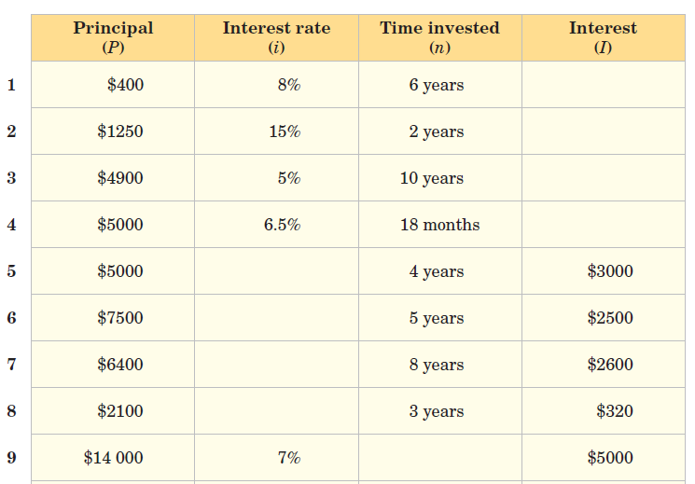
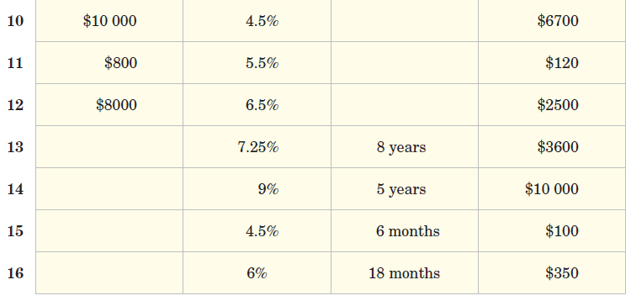
Use the appropriate formula to complete the table.
R = I x 100
PT
T = I x 100
PR
P = I x 100
RT
I = PRT
100

Slide 2
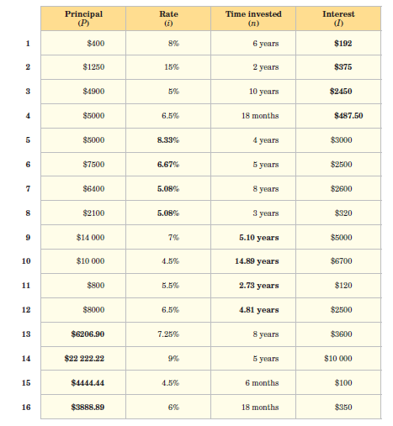
Answers

